Slide 1
numbers behind the test scores
Notes:
Talking about the work ive done with standardized tests in california

Slide 2
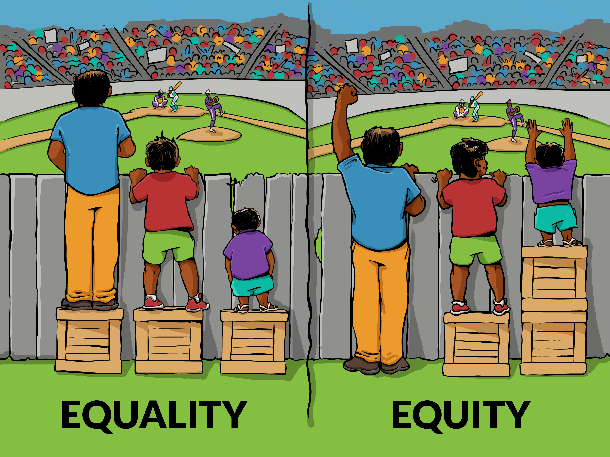
Standardized tests as a metric
CAN WE USE STUDENT DEMOGRAPHICS TO PREDICT ACADEMIC SUCCESS IN SCHOOLS?
Notes:
HOLD TEACHERS ACCOUNTABLE
TESTS used to measure ones ability
STANDARD that EVERYONE/YOU should be at
There are factors that students have little to no control over that affect their ability to MEET these standards
Challenge led me to the question…
DEFINE SUCCESS
Academic success in schools – average value for the standardized test (ENGLISH portion)
Put numbers into perspective
Everybody is a genius. But if you judge a fish by its ability to climb a tree, it will live its whole life believing that it is stupid

Slide 3
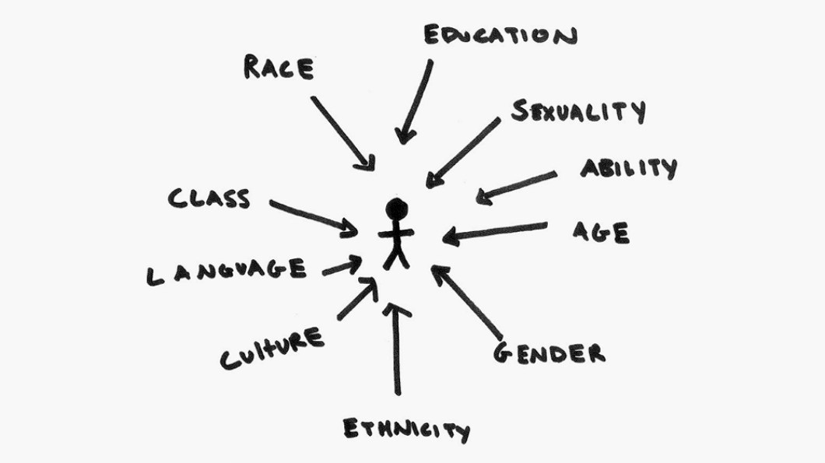
factors
Notes:
ETHNICITY AND ECONOMIC STATUS

Slide 4
How did we do it?
DATA COLLECTION
Notes:
Data from dept of education
Dataset of schools, number of students that met different demographic criteria, and average test scores

Slide 5
How did we do it?
DATA COLLECTION
CLEAN & TRANSFORM DATA
Notes:
Don’t misinterpret as tampering, presenting in best possible form for our model

Slide 6
How did we do it?
DATA COLLECTION
CLEAN & TRANSFORM DATA
MODELING & INTERPRETING
Notes:
Led us to many models
Chose the best one

Slide 7
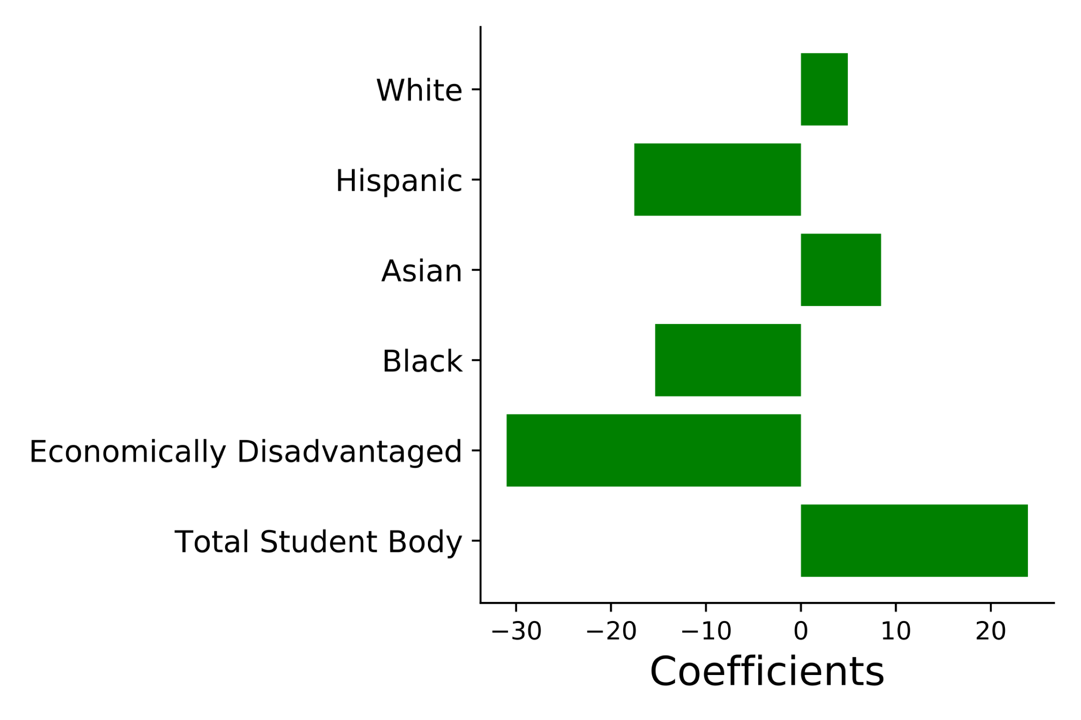
RESULTS
Notes:
Coefficients show the effect a given criteria has on the school’s average test score
The more directed to the right it is, the more positive it’s impact on the score and vice versa
This lines up with my understanding of the research already done on education

Slide 8
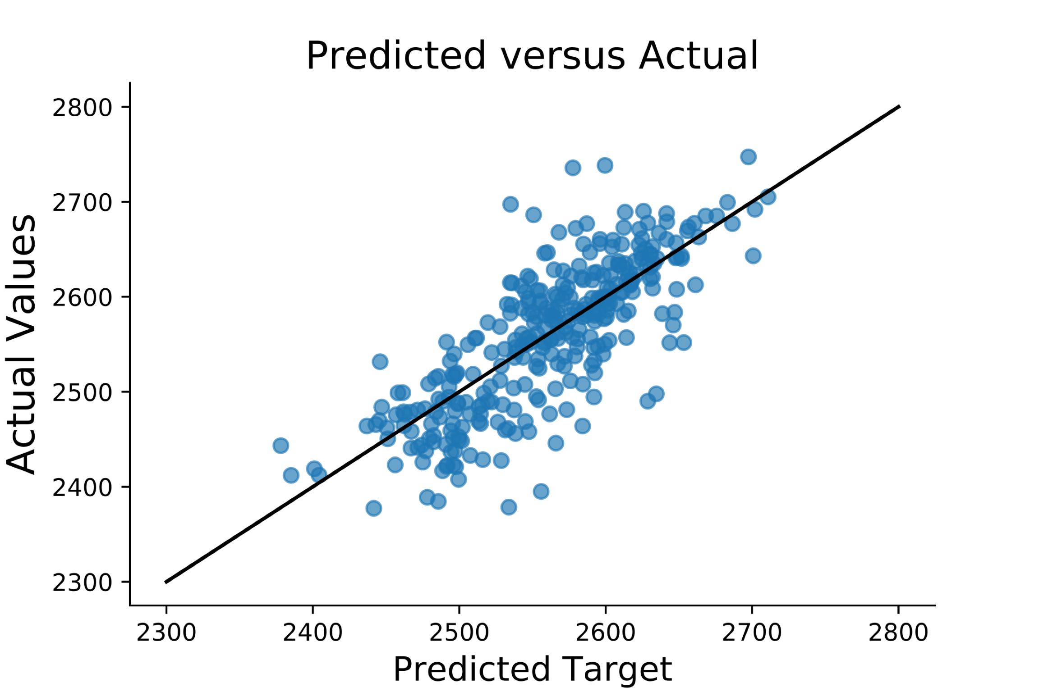
RESULTS
Notes:
Numbers and stats metrics behind this - for you to understand my perspective in choosing this model
Not necessary to see this is a good model - EYE TEST

Slide 9
Conclusions
Our model is viable!
Notes:
Our model takes students demographics and predicts the average test scores for schools with decent accuracy

Slide 10
Conclusions
Our model is viable!
It shouldn’t be used to predict school success
Notes:
SET THE BAR FOR A SCHOOL’S SUCCESS – accommodate factors
Could be used by districts to better understand how their schools are performing
Could be used by schools to better evaluate their teachers
Could be used by parents to put their child’s scores in context

Slide 11
FUTURE WORK
Additional Student Features
Parent education
English fluency
Migrant status
Neighborhood Characteristics
Number of parks
Average size of homes
Crime rate
Notes:
We have a fantastic baseline model to work with, and I believe that this has the potential to be an incredibly useful tool on a micro and macro level

Slide 12
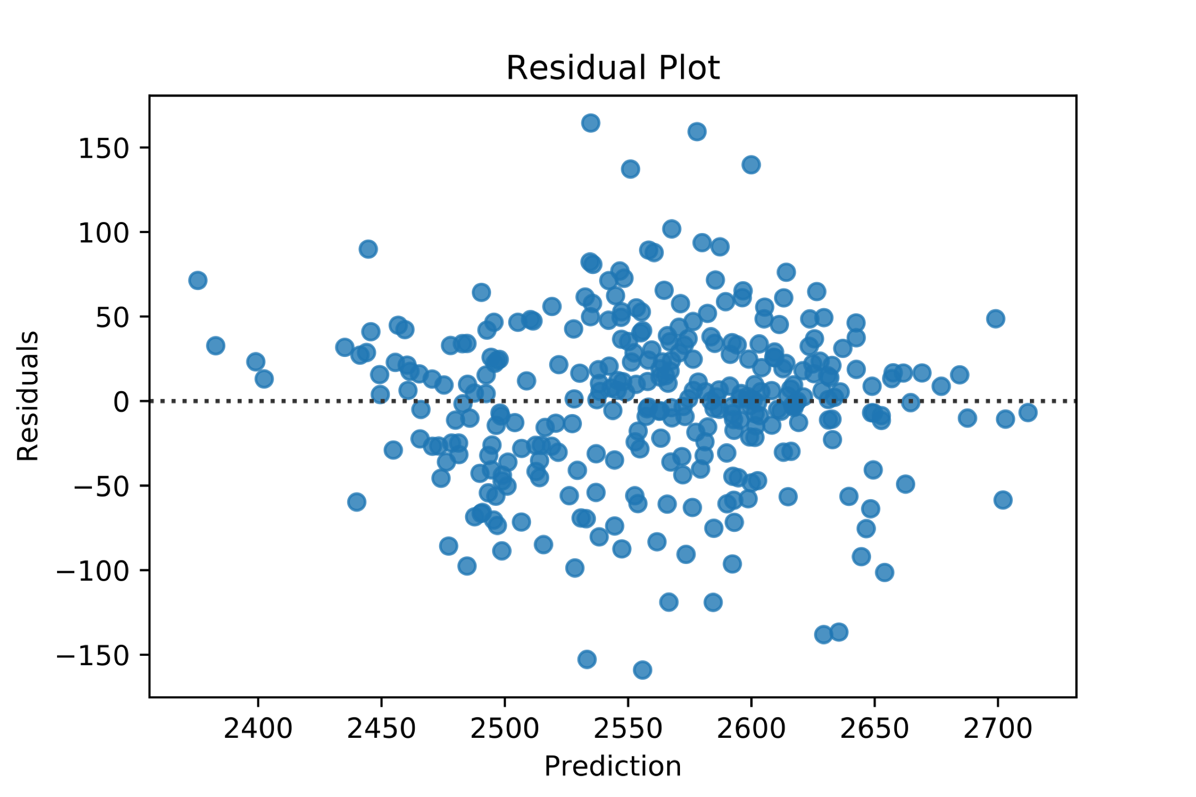
APPENDIX
METRIC | VALUE
Adj R², train Adj R², test | 0.625 0.618
P(F-statistic) | 8.95 E-10
Durbin-Watson | 2.006
Condition Number | 3.59

